Slide 1

Capstone: Warby Parker
Learn SQL from Scratch
Kevin Wheaton
1/28/19

Slide 2
Table of Contents
Quiz questions
1.1 What does this table tell us?
1.2 Where did users give up in the quiz funnel?
2. Home Try-On A/B Test
2.1 Setting up the A/B Test
2.2 Combining all three Tables

Slide 3
1. Quiz questions

Slide 4
1.1 What does this table tell us?
This table shows us the five questions that are visible to users and their responses. Using this data you can cater to each user individually by recommending them items based on their responses.
SELECT *
FROM survey
LIMIT 10;
Question | User_id | Response
1. What are you looking for | 005e7f99-d48c-4fce-b605-10506c85aaf7 | Women’s Styles
2. What’s your fit? | 005e7f99-d48c-4fce-b605-10506c85aaf7 | Medium
3. Which shapes do you like? | 005e7f99-d48c-4fce-b605-10506c85aaf7 | Round
4. Which colors do you like? | 005e7f99-d48c-4fce-b605-10506c85aaf7 | Two-Tone
5. When was your last eye exam? | 005e7f99-d48c-4fce-b605-10506c85aaf7 | <1 year

Slide 5
1.2 Where did users give up in the quiz funnel?
This table shows us the total amount of responses to each question and their completion rate. You can see that the third and fifth question have the lowest completion rate. This could be for a few reasons:
The user just wants to browse the selections and only needs to give the bare minimum information which doesn’t need to include shape preferences.
If the user wants to go more in depth by answering the shape question, then its not too far of a stretch to answer what colors the user prefers.
The last question can be seen as an attack or an insult to the user. It is also a somewhat personal question. Since you just answered four questions about product preferences, this question can imply your taste is bad. It is also a question that even friends will not just ask you out of pure interest. Unlike the other questions, this one can have a perceived wrong answer and make the user feel bad.
SELECT question,
Count(distinct user_id)
From survey
Group By question;
Question | Count(Distinct user_id) | Completion Rate
1. What are you looking for | 500 | 100%
2. What’s your fit? | 475 | 95%
3. Which shapes do you like? | 380 | 80%
4. Which colors do you like? | 361 | 95%
5. When was your last eye exam? | 270 | 74.79%

Slide 6
2. Home Try-On A/B Test

Slide 7
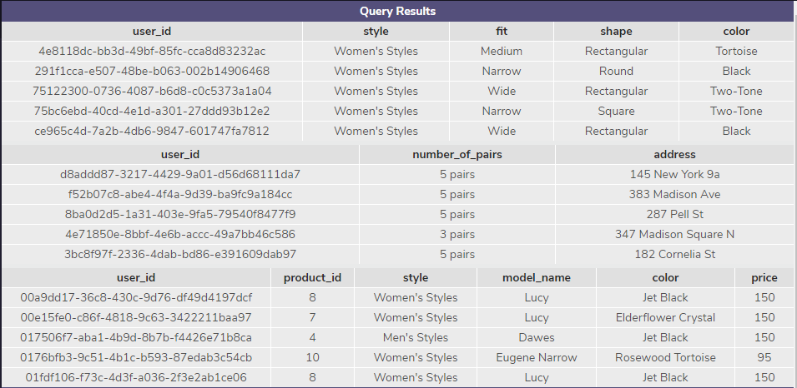
2.1 Setting up the A/B test
This gives us three separate tables, each with their own columns and a user_id to tie them together. Now we see each user_id in all three tables can be joined together, so that the information in all three tables can be combined into one. Below is a picture of the table that the query to the right will show.
SELECT *
FROM quiz
LIMIT 5;
SELECT *
FROM home_try_on
LIMIT 5;
SELECT *
FROM purchase
LIMIT 5;

Slide 8
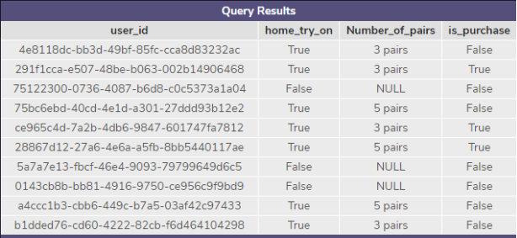
2.2 Combining all three Tables
By using a left join we can get all the records from the first table, which is quiz, and then get the records from each subsequent table from the selected columns. We get NULL as data when there are no related records. There are several ways Warby-Parker can use this data:
You can calculate purchase rates between customers who tried the home_try_on and those who didn’t
You can calculate if customers who had more pairs of shoes would be more likely to purchase more products.
You can calculate if answering the quiz questions has a better chance of making a sale by comparing conversion rates from the user_id’s who answered the question, and those who didn’t, to user_id’s who made a purchase.
SELECT Distinct quiz.user_id,
CASE
WHEN
home_try_on.user_id IS NOT NULL
THEN ‘True’
ELSE ‘False’
END AS home_try_on,
CASE
WHEN
number_of_pairs.user_id IS NULL
THEN ‘NULL’
ELSE ‘number_of_pairs’
END AS number_of_pairs,
CASE
WHEN
purchase.user_id IS NOT NULL
THEN ‘True’
ELSE ‘False’
END AS is_purchase
FROM quiz
LEFT JOIN home_try_on
ON home_try_on.user_id = quiz.user_id
LEFT JOIN purchase
ON purchase.user_id = home_try_on_id
LIMIT 10;

